Slide 1
Homework Assignment #1 PID manager
Professor： Hsung-Pin Chang
TA ：Yung-Hsu Chu

Slide 2
Outline
Background
What is a PID ?
What a PID manager does ?
Bitmap
Homework Assignment #1
Reference

Slide 3
What is a PID ?
PID: process identifier
Most operating systems identify processes according to
a unique PID
UNIX
Linux
Windows
Typically is an unsigned integer.
Used as an index to access various attributes of a process within the kernel.

Slide 4
What a PID manager does ?
An operating system’s PID manager is responsible for managing process identifiers (PID).
When a process is created：
It’s assigned a unique PID by PID manager
When the process completes：
The PID is returned to the PID manager
PID manager can re-assign the returned PID later
No two active processes can have the same PID.

Slide 5
Bitmap
A string of n bits represent the status of n items.
For each bit, 0 means free and 1 means allocated
Example ：a bit in a bitmap
item
PID i
bit
1 unavailable
0 available
status

Slide 6
Bitmap
A string of n bits represent the status of n items.
A[0] represents the status of PID 0~PID 31
A[1] represents the status of PID 32~PID 63
......
available
unavailable
int A[ ]
31
15
0
PID
A[ 0 ]
0
31 |  |  |  |  |  |  | 24
23 |  |  |  |  |  |  | 16
0
15 |  |  |  |  |  |  | 8
 |  |  |  |  |  |  | 1
7 |  |  |  |  |  |  | 0
digit
unavailable
available
63
47
32
A[ 1 ]
0
31 |  |  |  |  |  |  | 24
23 |  |  |  |  |  |  | 16
1
15 |  |  |  |  |  |  | 8
 |  |  |  |  |  |  | 0
7 |  |  |  |  |  |  | 0
.
.
.

Slide 7
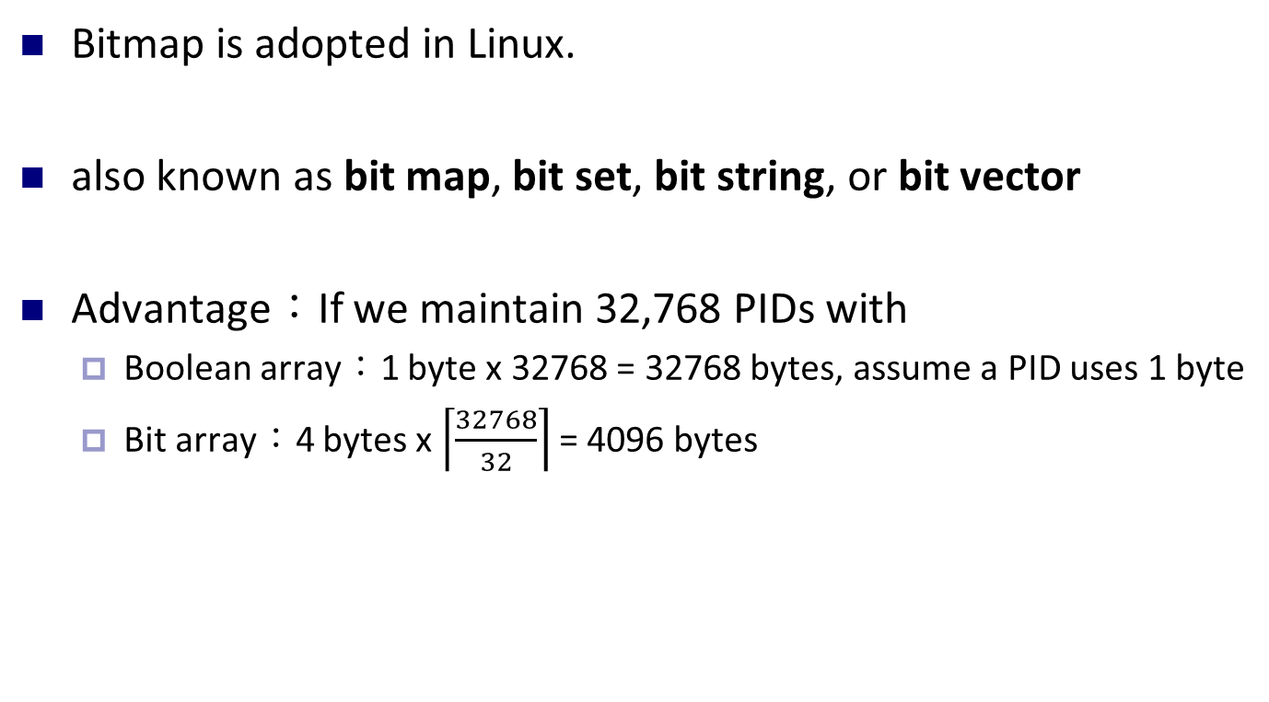
Bitmap (cont.)

Slide 8
Bitmap (cont.)
A[47/32] = A[47/32] | (1<<(47%32))
A[1] = A[1] | (1<<(15))
Bitmap operation
setBit(A, k)
A[(k/32)] = A[(k/32)]| (1 << (k%32))
31
15
0
A[ 0 ]
31 |  |  |  |  |  |  | 24
23 |  |  |  |  |  |  | 16
15 |  |  |  |  |  |  | 8
7 |  |  |  |  |  |  | 0
63
47
32
A[ 1 ]
31 |  |  |  |  |  |  | 24
23 |  |  |  |  |  |  | 16
0
15 |  |  |  |  |  |  | 8
7 |  |  |  |  |  |  | 0
0 | 0 | 0 | 0 | 0 | 0 | 0 | 0
23 |  |  |  |  |  |  | 16
0 | 0 | 0 | 0 | 0 | 0 | 0 | 0
15 |  |  |  |  |  |  | 8
0 | 0 | 0 | 0 | 0 | 0 | 0 | 1
7 |  |  |  |  |  |  | 0
0 | 0 | 0 | 0 | 0 | 0 | 0 | 0
31 |  |  |  |  |  |  | 24
0 | 0 | 0 | 0 | 0 | 0 | 0 | 0
23 |  |  |  |  |  |  | 16
0 | 0 | 0 | 0 | 0 | 0 | 0 | 0
31 |  |  |  |  |  |  | 24
1 | 0 | 0 | 0 | 0 | 0 | 0 | 0
15 |  |  |  |  |  |  | 8
1
0 | 0 | 0 | 0 | 0 | 0 | 0 | 0
7 |  |  |  |  |  |  | 0

Slide 9
Bitmap (cont.)
setBit
63
47
32
A[ 1 ]
31 |  |  |  |  |  |  | 24
23 |  |  |  |  |  |  | 16
0
15 |  |  |  |  |  |  | 8
7 |  |  |  |  |  |  | 0
OR operation
1
0 | 0 | 0 | 0 | 0 | 0 | 0 | 0
31 |  |  |  |  |  |  | 24
0 | 0 | 0 | 0 | 0 | 0 | 0 | 0
23 |  |  |  |  |  |  | 16
1 | 0 | 0 | 0 | 0 | 0 | 0 | 0
15 |  |  |  |  |  |  | 8
0 | 0 | 0 | 0 | 0 | 0 | 0 | 0
7 |  |  |  |  |  |  | 0
=
47
32
63
A[ 1 ]
31 |  |  |  |  |  |  | 24
23 |  |  |  |  |  |  | 16
1
15 |  |  |  |  |  |  | 8
7 |  |  |  |  |  |  | 0

Slide 10
Bitmap (cont.)
A[47/32] = A[47/32] &~ (1<<(47%32))
A[1] = A[1] &~ (1<<(15))
clearBit(A, k)
A[(k/32)] = A [k/32]& ~(1 << (k%32))
31
15
0
A[ 0 ]
31 |  |  |  |  |  |  | 24
23 |  |  |  |  |  |  | 16
15 |  |  |  |  |  |  | 8
7 |  |  |  |  |  |  | 0
63
47
32
A[ 1 ]
31 |  |  |  |  |  |  | 24
23 |  |  |  |  |  |  | 16
1
15 |  |  |  |  |  |  | 8
7 |  |  |  |  |  |  | 0
0 | 0 | 0 | 0 | 0 | 0 | 0 | 0
23 |  |  |  |  |  |  | 16
0 | 0 | 0 | 0 | 0 | 0 | 0 | 0
15 |  |  |  |  |  |  | 8
0 | 0 | 0 | 0 | 0 | 0 | 0 | 0
31 |  |  |  |  |  |  | 24
1 | 1 | 1 | 1 | 1 | 1 | 1 | 1
23 |  |  |  |  |  |  | 16
0
1 | 1 | 1 | 1 | 1 | 1 | 1 | 1
31 |  |  |  |  |  |  | 24
0 | 0 | 0 | 0 | 0 | 0 | 0 | 0
23 |  |  |  |  |  |  | 16
0 | 1 | 1 | 1 | 1 | 1 | 1 | 1
15 |  |  |  |  |  |  | 8
0 | 0 | 0 | 0 | 0 | 0 | 0 | 1
7 |  |  |  |  |  |  | 0
0 | 0 | 0 | 0 | 0 | 0 | 0 | 0
31 |  |  |  |  |  |  | 24
1 | 0 | 0 | 0 | 0 | 0 | 0 | 0
15 |  |  |  |  |  |  | 8
1 | 1 | 1 | 1 | 1 | 1 | 1 | 1
7 |  |  |  |  |  |  | 0
0 | 0 | 0 | 0 | 0 | 0 | 0 | 0
7 |  |  |  |  |  |  | 0

Slide 11
Bitmap (cont.)
ClearBit
63
47
32
A[ 1 ]
31 |  |  |  |  |  |  | 24
23 |  |  |  |  |  |  | 16
0
15 |  |  |  |  |  |  | 8
7 |  |  |  |  |  |  | 0
AND operation
1
1 | 1 | 1 | 1 | 1 | 1 | 1 | 1
31 |  |  |  |  |  |  | 24
1 | 1 | 1 | 1 | 1 | 1 | 1 | 1
23 |  |  |  |  |  |  | 16
0 | 1 | 1 | 1 | 1 | 1 | 1 | 1
15 |  |  |  |  |  |  | 8
1 | 1 | 1 | 1 | 1 | 1 | 1 | 1
7 |  |  |  |  |  |  | 0
=
47
32
63
A[ 1 ]
31 |  |  |  |  |  |  | 24
23 |  |  |  |  |  |  | 16
0
15 |  |  |  |  |  |  | 8
7 |  |  |  |  |  |  | 0

Slide 12
Bitmap (cont.)
x=0 00000000 00000000 00000000 00000000
0
NOT 0
x=1 00000000 00000000 10000000 00000000
testBit(A, k)
tmp = A[(k/32)] & (1 << (k%32))
31
15
0
A[ 0 ]
31 |  |  |  |  |  |  | 24
23 |  |  |  |  |  |  | 16
15 |  |  |  |  |  |  | 8
7 |  |  |  |  |  |  | 0
63
47
32
A[ 1 ]
31 |  |  |  |  |  |  | 24
23 |  |  |  |  |  |  | 16
x
15 |  |  |  |  |  |  | 8
7 |  |  |  |  |  |  | 0
0 | 0 | 0 | 0 | 0 | 0 | 0 | 0
23 |  |  |  |  |  |  | 16
0 | 0 | 0 | 0 | 0 | 0 | 0 | 0
15 |  |  |  |  |  |  | 8
1
0 | 0 | 0 | 0 | 0 | 0 | 0 | 0
31 |  |  |  |  |  |  | 24
0 | 0 | 0 | 0 | 0 | 0 | 0 | 0
23 |  |  |  |  |  |  | 16
0 | 0 | 0 | 0 | 0 | 0 | 0 | 1
7 |  |  |  |  |  |  | 0
0 | 0 | 0 | 0 | 0 | 0 | 0 | 0
31 |  |  |  |  |  |  | 24
1 | 0 | 0 | 0 | 0 | 0 | 0 | 0
15 |  |  |  |  |  |  | 8
0 | 0 | 0 | 0 | 0 | 0 | 0 | 0
7 |  |  |  |  |  |  | 0

Slide 13
Bitmap (cont.)
TestBit
63
47
32
A[ 1 ]
31 |  |  |  |  |  |  | 24
23 |  |  |  |  |  |  | 16
x
15 |  |  |  |  |  |  | 8
7 |  |  |  |  |  |  | 0
And operation
1<<15
0 | 0 | 0 | 0 | 0 | 0 | 0 | 0
31 |  |  |  |  |  |  | 24
0 | 0 | 0 | 0 | 0 | 0 | 0 | 0
23 |  |  |  |  |  |  | 16
1 | 0 | 0 | 0 | 0 | 0 | 0 | 0
15 |  |  |  |  |  |  | 8
0 | 0 | 0 | 0 | 0 | 0 | 0 | 0
7 |  |  |  |  |  |  | 0
=
tmp
0 | 0 | 0 | 0 | 0 | 0 | 0 | 0
31 |  |  |  |  |  |  | 24
0 | 0 | 0 | 0 | 0 | 0 | 0 | 0
23 |  |  |  |  |  |  | 16
x | 0 | 0 | 0 | 0 | 0 | 0 | 0
15 |  |  |  |  |  |  | 8
0 | 0 | 0 | 0 | 0 | 0 | 0 | 0
7 |  |  |  |  |  |  | 0
If x = 1, tmp != 0
If x = 0,tmp = 0

Slide 14
Outline
Background
What is a PID ?
What a PID manager does ?
Bitmap
Homework Assignment #1
Reference

Slide 15
Homework Assignment #1
Implement PID manager which provides three APIs：
int allocate_map( void )：
Creates and initializes a data structure for representing PIDs;
returns −1 if unsuccessful, 1 if successful
int allocate_pid( void )：
Allocates and returns a PID; returns −1 if unable to allocate a PID (all PIDs are in use)
void release_pid( int pid )：
Releases a PID

Slide 16
Homework Assignment #1 (cont.)
Demands：
Implement PID manager and design a user interface to test your PID manager
The interface should include
Create a process
Delete a process
Exit
You need to using three APIs you Implemented
Define PID range
#define MINPID 0
#define MAXPID 128

Slide 17
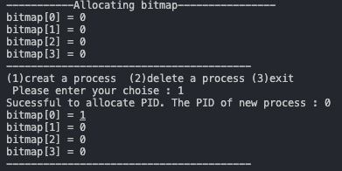
Homework Assignment #1 (cont.)
Result：
allocate_map
allocate_pid
0 | 0 | 0 | 0 | 0 | 0 | 0 | 0
15 |  |  |  |  |  |  | 8
0 | 0 | 0 | 0 | 0 | 0 | 0 | 0
7 |  |  |  |  |  |  | 0
1

Slide 18
Homework Assignment #1 (cont.)
Result：
0 | 0 | 0 | 0 | 0 | 0 | 0 | 0
15 |  |  |  |  |  |  | 8
0 | 0 | 0 | 0 | 0 | 0 | 0 | 1
7 |  |  |  |  |  |  | 0

Slide 19
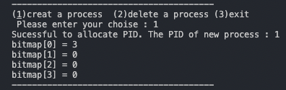
Homework Assignment #1 (cont.)
Result：
0 | 0 | 0 | 0 | 0 | 0 | 0 | 0
15 |  |  |  |  |  |  | 8
0 | 0 | 0 | 0 | 0 | 0 | 1 | 1
7 |  |  |  |  |  |  | 0

Slide 20
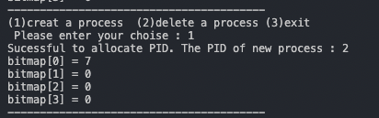
Homework Assignment #1 (cont.)
Result：
0 | 0 | 0 | 0 | 0 | 0 | 0 | 0
15 |  |  |  |  |  |  | 8
0 | 0 | 0 | 0 | 0 | 1 | 1 | 1
7 |  |  |  |  |  |  | 0

Slide 21
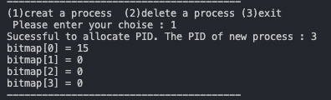
Homework Assignment #1 (cont.)
Result：
0 | 0 | 0 | 0 | 0 | 0 | 0 | 0
15 |  |  |  |  |  |  | 8
0 | 0 | 0 | 0 | 1 | 1 | 1 | 1
7 |  |  |  |  |  |  | 0

Slide 22
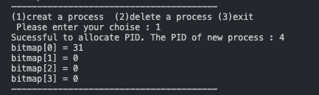
Homework Assignment #1 (cont.)
Result：
0 | 0 | 0 | 0 | 0 | 0 | 0 | 0
15 |  |  |  |  |  |  | 8
0 | 0 | 0 | 1 | 1 | 1 | 1 | 1
7 |  |  |  |  |  |  | 0

Slide 23
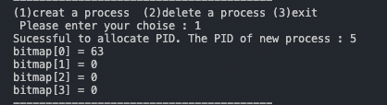
Homework Assignment #1 (cont.)
Result：
0 | 0 | 0 | 0 | 0 | 0 | 0 | 0
15 |  |  |  |  |  |  | 8
0 | 0 | 1 | 1 | 1 | 1 | 1 | 1
7 |  |  |  |  |  |  | 0

Slide 24
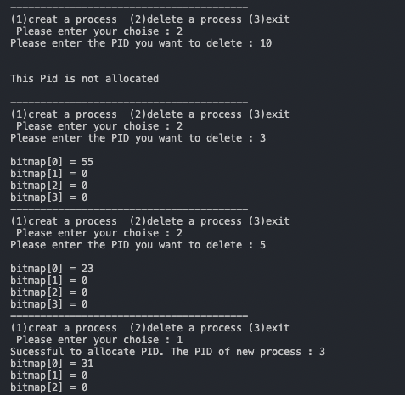
Homework Assignment #1 (cont.)
Result：
0 | 0
 | 8
0 | 0 | 1 | 1 | 1 | 1 | 1 | 1
7 |  |  |  |  |  |  | 0
0 | 0
 | 8
0 | 0 | 1 | 1 | 0 | 1 | 1 | 1
7 |  |  |  |  |  |  | 0
0 | 0
 | 8
0 | 0 | 0 | 1 | 0 | 1 | 1 | 1
7 |  |  |  |  |  |  | 0
0 | 0
 | 8
0 | 0 | 0 | 1 | 1 | 1 | 1 | 1
7 |  |  |  |  |  |  | 0

Slide 25

Homework Assignment #1 (cont.)
Result：

Slide 26
Turn In
Deadline：2023/ 10/ 10 P.M.11:59:59
Upload to iLearning
File name：
HW1_’ID’.zip (e.g. HW1_7108056057.zip)
Source code ( hw1.c )
Word file
If you don’t hand in your homework on time, your score will be deducted 10 points every day.

Slide 27
Rules
No cheat work is acceptable
You get zero if you copy other people’s version
Only single job is accepted

Slide 28
TA
Name： Yung-Hsu Chu
Email：ken09202000@gmail.com
Lab：OSLab (1001)

Slide 29
Reference
Textbook：Operating System Concepts, 10th Edition (chapter 3.3.1)
PID：
https://zh.wikipedia.org/wiki/%E8%BF%9B%E7%A8%8BID
Bitmap：
https://en.wikipedia.org/wiki/Bit_array
http://www.mathcs.emory.edu/~cheung/Courses/255/Syllabus/1-C-intro/bit-array.html

